Slide 1
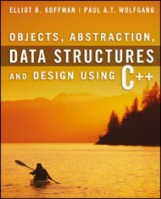
Welcome to
CS 235 Data Structures
Sequential Containers, 4.7-10 (14)

Slide 2
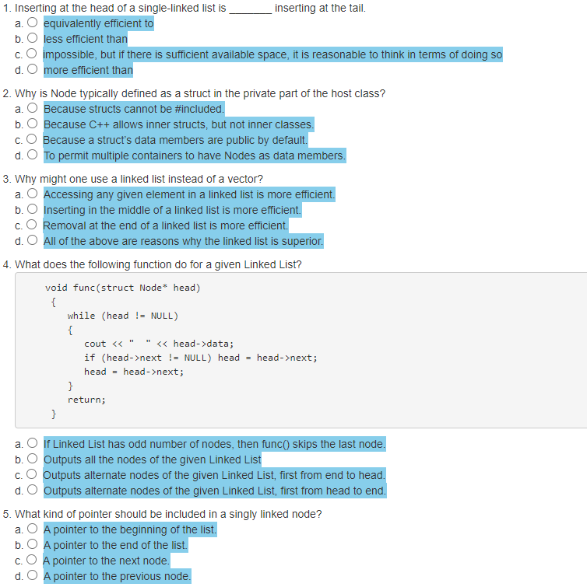
Attendance Quiz #13

Slide 3
Tip #14: eof in Loops
Anytime you see istream::eof() as a loop condition, the code is almost certainly wrong! Why??
Because iostream::eof will only return true after reading the end of the stream. (It does not indicate, that the next read will be the end of the stream.)
instream →
... | 'T' | 'h' | 'e' | ' ' | 'E' | 'n' | 'd'
EOF
Only now will the read set the eof bit (as well as the fail bit), but we process the data variable.
Better
int data; while(inStream >> data) { // NOT end of stream // do stuff with good data }
Bad
int data; while(!inStream.eof()) { // not end-of-file inStream >> data; // do stuff with good(??) data }
Best
string line; while(getline(in, line)) { istringstream inStream(line); int data; inStream >> data; ... }
We can be sure that the read was successful – otherwise the stream operator>> would have returned false and the loop would not have been entered..

Slide 4
Double-Linked Lists
Limitations of a single-linked list include:
Insertion at the front is O(1); insertion at other positions is O(n)
Insertion is convenient only after a referenced node.
Removing a node requires a reference to the previous node.
We can traverse the list only in the forward direction.
We can overcome these limitations by adding a reference in each node to the previous node, creating a double-linked list.

Slide 5
The DNode Class
template<typename T>
class DLinkedList : public DLinkedListInterface<T>
{
private:
struct DNode
{
T data;
DNode* next;
DNode* prev;
DNode(const T& d, DNode* pv = NULL, DNode* nx = NULL)
: data(d), next(nx), prev(pv) {}
};
DNode* head;
DNode* tail;
int num_items;
public:
/** ... */
}
Each Dnode has a next and a prev link.
A Doubly Linked List has a head and tail pointer

Slide 6
push_front("Rob")
newNode
Case 1:
DNode
next = prev = data = "Rob"
∅
∅
head
tail
∅
∅
DNode* newNode = new DNode(item, NULL, head);
if (head != NULL) head->prev = newNode;
head = newNode;
if (tail == NULL) tail = newNode;

Slide 7
push_front("Rob")
Case 1:
head
DNode
next = prev = data = "Rob"
tail
∅
∅
DNode* newNode = new DNode(item, NULL, head);
if (head != NULL) head->prev = newNode;
head = newNode;
if (tail == NULL) tail = newNode;

Slide 8
push_front("Sam")
newNode
Case 2:
DNode
next = prev = data = "Sam"
∅
head
DNode
next = prev = data = "Rob"
tail
∅
∅
DNode* newNode = new DNode(item, NULL, head);
if (head != NULL) head->prev = newNode;
head = newNode;
if (tail == NULL) tail = newNode;

Slide 9
push_front("Sam")
Case 2:
head
DNode
next = prev = data = "Sam"
DNode
next = prev = data = "Rob"
tail
∅
∅
DNode* newNode = new DNode(item, NULL, head);
if (head != NULL) head->prev = newNode;
head = newNode;
if (tail == NULL) tail = head;

Slide 10
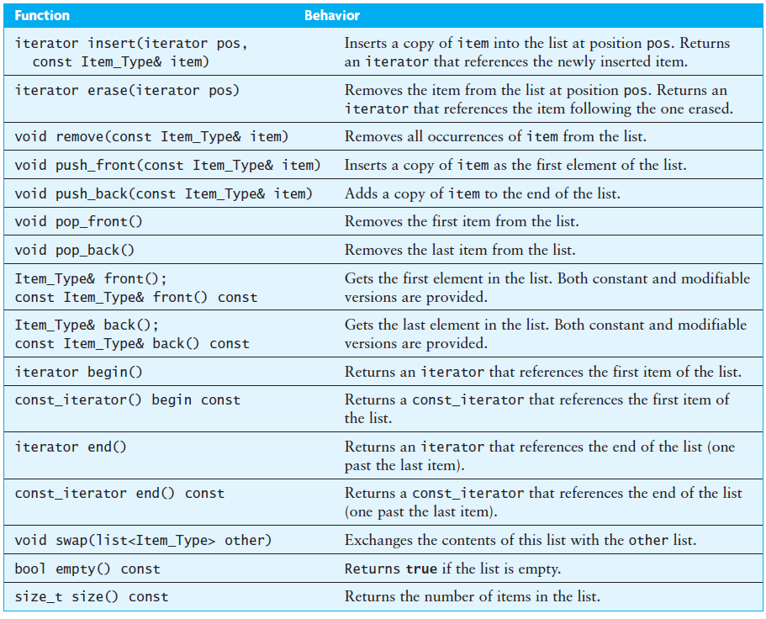
The list Class – Double-linked List

Slide 11
Ordered Insertion of "Rob"
newNode
DNode
next = prev = data = "Rob"
node_ptr
node_ptr
node_ptr
∅
∅
head
DNode
next = prev = data = "Harry"
DNode
next = prev = data = "Max"
DNode
next = prev = data = "Tom"
tail
∅
∅
Node* node_ptr = head; // find insertion point
while (node_ptr->data < "Rob")
node_ptr = node_ptr->next;
Node* newNode = new Node("Rob");
rob->next = node_ptr; // Step 1

Slide 12
Ordered Insertion of "Rob"
newNode
DNode
next = prev = data = "Rob"
node_ptr
∅
head
DNode
next = prev = data = "Harry"
DNode
next = prev = data = "Max"
DNode
next = prev = data = "Tom"
tail
∅
∅
Node* node_ptr = head; // find insertion point
while (node_ptr->data < "Rob")
node_ptr = node_ptr->next;
Node* newNode = new Node("Rob");
rob->next = node_ptr; // Step 1
node_ptr->prev->next = newNode; // Step 2

Slide 13
Ordered Insertion of "Rob"
newNode
DNode
next = prev = data = "Rob"
node_ptr
∅
head
DNode
next = prev = data = "Harry"
DNode
next = prev = data = "Max"
DNode
next = prev = data = "Tom"
tail
∅
∅
Node* node_ptr = head; // find insertion point
while (node_ptr->data < "Rob")
node_ptr = node_ptr->next;
Node* newNode = new Node("Rob");
rob->next = node_ptr; // Step 1
node_ptr->prev->next = newNode; // Step 2
rob->prev = node_ptr->prev; // Step 3

Slide 14
Ordered Insertion of "Rob"
newNode
DNode
next = prev = data = "Rob"
node_ptr
head
DNode
next = prev = data = "Harry"
DNode
next = prev = data = "Max"
DNode
next = prev = data = "Tom"
tail
∅
∅
Node* node_ptr = head; // find insertion point
while (node_ptr->data < "Rob")
node_ptr = node_ptr->next;
Node* newNode = new Node("Rob");
rob->next = node_ptr; // Step 1
node_ptr->prev->next = newNode; // Step 2
rob->prev = node_ptr->prev; // Step 3
node_ptr->prev = newNode; // Step 4

Slide 15
Ordered Insertion of "Rob"
newNode
DNode
next = prev = data = "Rob"
node_ptr
head
DNode
next = prev = data = "Harry"
DNode
next = prev = data = "Max"
DNode
next = prev = data = "Tom"
tail
∅
∅
Node* node_ptr = head; // find insertion point
while (node_ptr->data < "Rob")
node_ptr = node_ptr->next;
Node* newNode = new Node("Rob");
rob->next = node_ptr; // Step 1
node_ptr->prev->next = newNode; // Step 2
rob->prev = node_ptr->prev; // Step 3
node_ptr->prev = newNode; // Step 4

Slide 16
Delete "Rob"
node_ptr
node_ptr
node_ptr
head
DNode
next = prev = data = "Harry"
DNode
next = prev = data = "Max"
DNode
next = prev = data = "Rob"
DNode
next = prev = data = "Tom"
tail
∅
∅
Node* node_ptr = head; // find "Rob" point
while (node_ptr->data != "Rob")
node_ptr = node_ptr->next;
node_ptr->prev->next = node_ptr->next; // Step 1

Slide 17
Delete "Rob"
node_ptr
head
DNode
next = prev = data = "Harry"
DNode
next = prev = data = "Max"
DNode
next = prev = data = "Rob"
DNode
next = prev = data = "Tom"
tail
∅
∅
Node* node_ptr = head; // find "Rob" point
while (node_ptr->data != "Rob")
node_ptr = node_ptr->next;
node_ptr->prev->next = node_ptr->next; // Step 1
node_ptr->next->prev = node_ptr->prev; // Step 2

Slide 18
Delete "Rob"
node_ptr
head
DNode
next = prev = data = "Harry"
DNode
next = prev = data = "Max"
DNode
next = prev = data = "Rob"
DNode
next = prev = data = "Tom"
tail
∅
∅
Node* node_ptr = head; // find "Rob" point
while (node_ptr->data != "Rob")
node_ptr = node_ptr->next;
node_ptr->prev->next = node_ptr->next; // Step 1
node_ptr->next->prev = node_ptr->prev; // Step 2
Delete node_ptr; // Step 3

Slide 19
Delete "Rob"
head
DNode
next = prev = data = "Harry"
DNode
next = prev = data = "Max"
DNode
next = prev = data = "Tom"
tail
∅
∅
Node* node_ptr = head; // find "Rob" point
while (node_ptr->data != "Rob")
node_ptr = node_ptr->next;
node_ptr->prev->next = node_ptr->next; // Step 1
node_ptr->next->prev = node_ptr->prev; // Step 2
Delete node_ptr; // Step 3

Slide 20
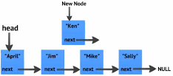
4.8 Application of the list Class
Case Study: Maintaining an Ordered List
4.8, pgs. 285-286

Slide 21
Application of the list Class
Problem
We want to maintain this list so that it will be in alphabetical order even after students have added and dropped the course.
Analysis
Develop a general Ordered_List class that can be used to store any group of objects that can be compared using the less-than operator.
Solution
Write a new Ordered_List class that inherits (is-a) a C++ list class and over-ride all the list functions.
✗
Write a new Ordered_List class that contains (has-a) a C++ list class.
Use the list class to store the items.
Use list functions where appropriate (delegation).
Only write new functions where needed, namely insertion.

Slide 22
Ordered Linked List Insertion
Algorithm for Insertion
Find the first item in the list that is greater than or equal to the item to be inserted
Create an iterator that starts at the beginning of the list
While the iterator is not at the end and the item at the iterator position is less than the item to be inserted
Advance the iterator
Insert the new item before this one.

Slide 23
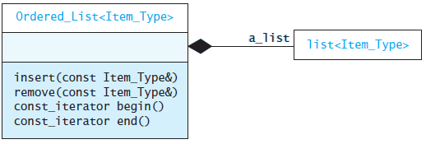
Delegation
Code for Insertion
Inside a declaration or a definition of a template, typename can be used to declare that a dependent name is a type.
void insert(const Item_Type& an_item)
{
// point to the first item >= an_item or the end
typename list<Item_Type>::iterator iter = a_list.begin();
// find insertion point
while (iter != a_list.end() && *iter < an_item) ++iter;
// now insert in list
a_list.insert(iter, an_item);
}
A delegate is a class or method that wraps a pointer or reference to an object instance, a member method of that object's class to be called on that object instance and provides a method to trigger that call.
Use Delegation for the Other Functions
void remove(const Item_Type& item)
{
a_list.remove(item);
}

Slide 24
Circular Lists
Circular double-linked list:
Link last node to the first node, and
Link first node to the last node
We can also build single-linked circular lists:
Traverse in forward direction only
If we keep a pointer to tail, we can access the last element and the first element in O(1) time
Advantages:
Continue to traverse even after passing the first or last node
Visit all elements from any starting point
Never fall off the end of a list
Disadvantage: The code must avoid an infinite loop!

Slide 25
Be Safe

